Slide 1

2026 second QUARTER PRISON ADMISSIONS AND DISCHARGES STATISTICS REPORT
PRESENTED
BY
X. MOYO
STATISTICIAN: social statistics
7TH OCTOBER 2026

Slide 2
Outline of Presentation
Prison Population Size
New Admissions
Discharges
Profile of New Prisoners
Committed Crimes
2ND QUARTER 2026 PRISON ADMISSIONS AND DISCHARGES STATISTICS

Slide 3
Introduction
Zimbabwe National Statistics Agency (ZIMSTAT) collects administrative data on prisoners from Zimbabwe Prisons and Correctional Services (ZPCS) for use in the production of Quarterly Prison Admissions and Discharges Statistics reports.
The 2026 2nd Quarter Prison Admissions and Discharges Statistics report sheds light on the prison population, the number and profile of prisoners who get admitted into, and those who get discharged from the country’s prison facilities.
2ND QUARTER 2026 PRISON ADMISSIONS AND DISCHARGES STATISTICS

Slide 4
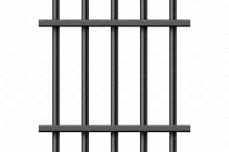

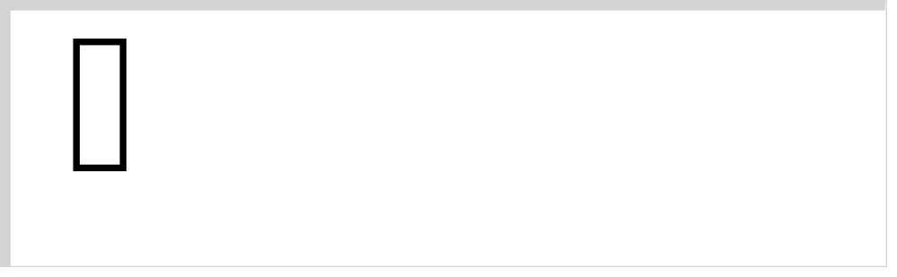
Results
Prison Population
At the end of the second quarter of 2026 there were 25,990 prisoners in prison facilities throughout the country.
25,057 (96.4 %)
933 (3.6 %)
2ND QUARTER 2026 PRISON ADMISSIONS AND DISCHARGES STATISTICS

Slide 5

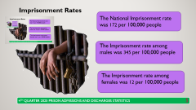

Imprisonment Rates
The National Imprisonment rate was 161 per 100,000 people
The Imprisonment rate among males was 323 per 100,000 people
The Imprisonment rate among females was 11 per 100,000 people
2ND QUARTER 2026 PRISON ADMISSIONS AND DISCHARGES STATISTICS

Slide 6
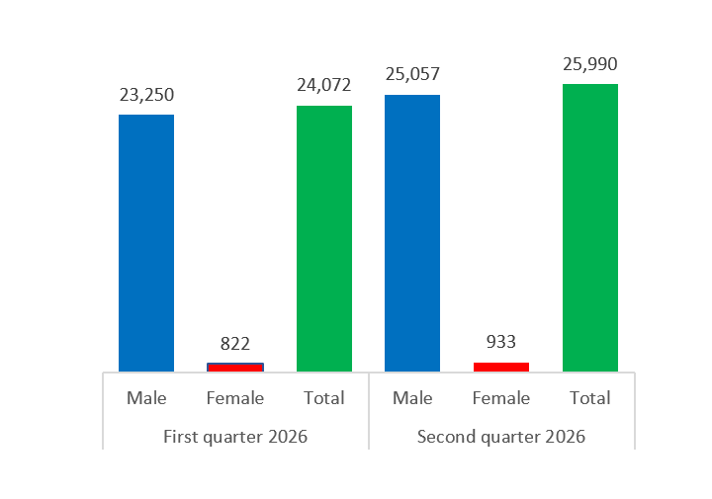
Comparison of Prison Population Between 1st Quarter 2026 and 2nd Quarter 2026
The prison population increased from 24,072 in Q1 of 2026 to 25,990 in Q2 of 2026.
During the same period, the population of male prisoners increased from 23,250 to 25,057
Female prisoners, too increased from 822 in Q1 of 2026 to 933 in Q2 of 2026.
2ND QUARTER 2026 PRISON ADMISSIONS AND DISCHARGES STATISTICS

Slide 7
Prison Population (Sentenced and Unsentenced Prisoners)
Among the 25,990 prisoners held in Zimbabwe’s prisons, 22,008 (84.7%) were sentenced and 3,982 (15.3%) were unsentenced.
Sentenced 21,280 (84.9%)
Unsentenced 3,777 (15.1%)
Of 25,057 male prisoners, 21,280 (84.9%) were and sentenced and 3,777 (15.1%) were unsentenced
Among the 933 female prisoners, 728 (78.0%) were sentenced and 205(22.0%) were unsentenced
Sentenced 728 (78.0%)
Unsentenced 205(22.0%)
2ND QUARTER 2026 PRISON ADMISSIONS AND DISCHARGES STATISTICS

Slide 8
Sentence Status of Prisoner Population: 1st Quarter 2026 and 2nd Quarter 2026
Sentenced prisoners increased from to 19,569 in Q1 of 2026 to 22,008
in Q2 of 2026
During the same period unsentenced prisoners decreased from 4,503 to 3,982.
Sentenced male prisoners increased from 18,953 to 21,280.
Unsentenced male prisoners decreased from 4,297 to 3,777.
Sentenced female prisoners also increased slightly from 616 to 728.
Unsentenced female prisoners decreased slightly from 206 in Q1 of 2026 to 205 in Q2 of 2026.
1st quarter 2026
 | Sentenced | Unsentenced
Male | 18,953 | 4,297
Female | 616 | 206
Total | 19,569 | 4,503
2nd quarter 2026
 | Sentenced | Unsentenced
Male | 21,280 | 3,777
Female | 728 | 205
Total | 22,008 | 3,982
2ND QUARTER 2026 PRISON ADMISSIONS AND DISCHARGES STATISTICS

Slide 9

Prison Admissions: 2nd Quarter 2026
A total of 16,146 new prisoners were admitted during the 2nd Quarter of 2026
Male prisoners were 14,913 (92.4%)
Female prisoners were 1,233 (7.6%)
2ND QUARTER 2026 PRISON ADMISSIONS AND DISCHARGES STATISTICS

Slide 10
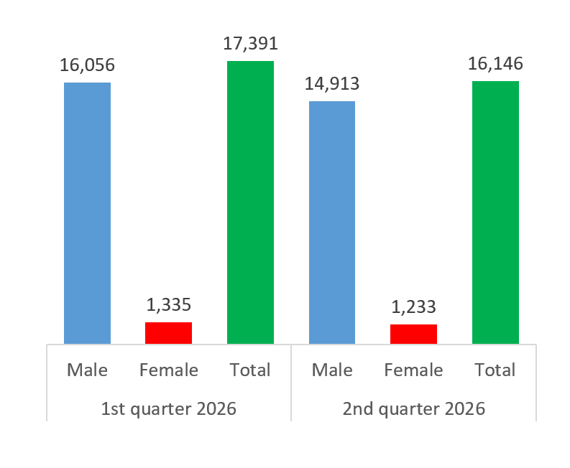
New Prison Admissions: 1st Quarter 2026 and 2nd Quarter 2026
The new prison admissions decreased from 17,391 in Q1 of 2026 to 16,146 in Q2 of 2026.
The new male prisoner population decreased from 16,056 to 14,913 and the population of new female prisoners decreased slightly from 1,335 to 1,233.
2ND QUARTER 2026 PRISON ADMISSIONS AND DISCHARGES STATISTICS

Slide 11
Prison Admissions (Continued)
Among the 16,146 new prisoners admitted, 12,281 (76.0%) were admitted as unsentenced prisoners and 3,868 (24. 0%) had a sentence.
11,322 (75.9%) were unsentenced
3,594 (24.1%) were sentenced.
959 (77.8%) were unsentenced
274 (22.2%) were sentenced.
2ND QUARTER 2026 PRISON ADMISSIONS AND DISCHARGES STATISTICS

Slide 12

Prison Discharges
A total of 14,133 prisoners were discharged from prison during the 2nd Quarter of 2026
12,984 (91.9%) were male
1,149 (8.1%) were female
2ND QUARTER 2026 PRISON ADMISSIONS AND DISCHARGES STATISTICS

Slide 13


Prison Discharges (Continued)
Of the 14,133 prisoners that were discharged during the quarter under review, 8,587 (60.8%) were serving a sentence and 5,546 (39.2%) were unsentenced
Sentenced 7,884 (60.7%)
Unsentenced 5,100 (39.3%)
Sentenced 703 (61.2%)
Unsentenced 446 (38.2%)
2ND QUARTER 2026 PRISON ADMISSIONS AND DISCHARGES STATISTICS
Notes:
Unsentenced- remanded out of custody free bail, or further

Slide 14
Reason(s) for Discharge from Prison
Sentenced prisoners
Unsentenced prisoners
Reason for discharge | Male | Female | Total
 | % | % | %
Sentence expired | 30.8 | 14.9 | 29.5
Community service | 26.6 | 38.1 | 27.5
Time to pay | 16.7 | 13.5 | 16.4
Fine paid | 11.9 | 16.2 | 12.3
Community service with time to pay | 5.7 | 5.1 | 5.6
Suspended sentence | 4.5 | 5 | 4.5
Other | 3.9 | 7.1 | 4.1
Amnesty parole | 0 | 0 | 0
Reason for discharge | Male | Female | Total
 | % | % | %
Bail paid or free bail | 46.1 | 49.3 | 46.4
Found not guilty by courts | 19.2 | 11.4 | 18.5
Case Withdrawn | 12.2 | 11.7 | 12.1
Remanded out of custody | 8 | 9 | 8.1
Released to immigration | 6.7 | 9.4 | 6.9
Other | 4.4 | 8.3 | 4.7
Further remand refused | 3.5 | 0.9 | 3.2
2ND QUARTER 2026 PRISON ADMISSIONS AND DISCHARGES STATISTICS

Slide 15

Profiling of New Prisoners by
Age group.
Province of usual residence
Nationality
Employment Status
2ND QUARTER 2026 PRISON ADMISSIONS AND DISCHARGES STATISTICS

Slide 16
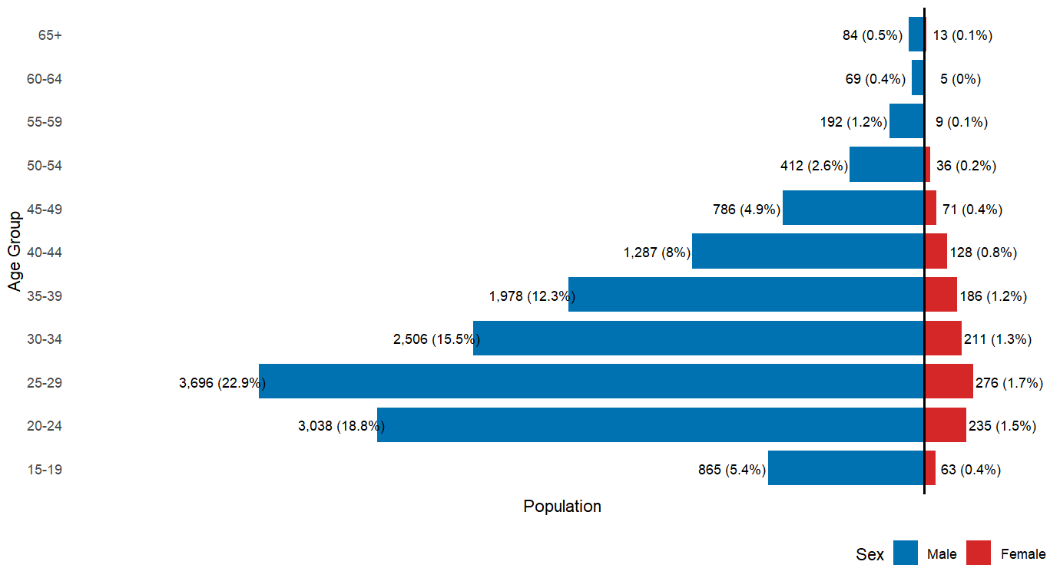
New Prisoners By Age Group And Sex
Across both sexes, individuals aged 25–29 account for the highest proportion of new prison admissions, with the 20–24 age group representing the second largest share. Following the peak observed in the 25–29 cohort, admissions decline consistently across successive older age categories. This pattern indicates that the likelihood of new admission decreases with increasing age.
13
2ND QUARTER 2026 PRISON ADMISSIONS AND DISCHARGES STATISTICS

Slide 17
New prisoners by Province of Usual Residence and sex
Most new prisoners usually lived in Harare (21.8%), followed by Manicaland (14.5%), Midlands (12.4%) and Mashonaland West (9.8%).
Most new male prisoners usually lived in Harare (20.8%), followed by Manicaland (14.6%) and Midlands (12.4%).
The majority of new female prisoners were from Harare (34.2%), followed by Manicaland (13.1%), Midlands (11.8%) Mashonaland Central (8.4%).
Province | Male | Female | Total
Harare | 20.8 | 34.2 | 21.8
Manicaland | 14.6 | 13.1 | 14.5
Midlands | 12.4 | 11.8 | 12.4
Mash West | 10 | 7.4 | 9.8
Masvingo | 8.5 | 6.1 | 8.3
Mash East | 7.8 | 6.9 | 7.7
Mash Central | 7.5 | 8.4 | 7.6
Bulawayo | 6.7 | 1.5 | 6.3
Mat South | 5.3 | 4.8 | 5.2
Mat North | 4.8 | 3.8 | 4.7
Outside Zimbabwe | 1.7 | 1.9 | 1.7
2ND QUARTER 2026 PRISON ADMISSIONS AND DISCHARGES STATISTICS

Slide 18
New prisoners population by Nationality and sex
Nationality | Male |  | Female |  | Total
 | Number | Percent | Number | Percent | Number | Percent
Zimbabwe | 14,612 | 98 | 1,207 | 97.9 | 15,819 | 98.0
Other SADC Countries | 176 | 1.2 | 13 | 1.1 | 189 | 1.2
Other African Countries | 23 | 0.2 | 5 | 0.4 | 28 | 0.2
Outside Africa | 102 | 0.7 | 8 | 0.6 | 110 | 0.7
Total | 14,913 | 100 | 1,233 | 100 | 16,146 | 100
Zimbabwe 98.0%
Other SADC
Countries 1.2%
Other African
Countries 0.2%
Outside
Africa 0.7%
2ND QUARTER 2026 PRISON ADMISSIONS AND DISCHARGES STATISTICS

Slide 19
Reported Last Employment Status of New Prisoners By Sex
51.9% of new prisoners reported being employed prior to admission.
Male prisoners who were unemployed constituted 46.9% of the new male prisoner population.
The share of female prisoners who reported that they were unemployed before their admission to prison was 62.9%
Employment status | Male |  | Female |  | Total
 | No | % | No | % | No | %
Employed | 7,926 | 53.1 | 457 | 37.1 | 8,383 | 51.9
Unemployed | 6,987 | 46.9 | 776 | 62.9 | 7,763 | 48.1
Total | 14,913 | 100 | 1,233 | 100 | 16,146 | 100
2ND QUARTER 2026 PRISON ADMISSIONS AND DISCHARGES STATISTICS

Slide 20




Crime Count For New Prisoners
The 16,146 prisoners that were admitted during the second quarter of 2026 had committed 18,719 offences. Of these offences, 17,353 were committed by males and 1,366 by females.
19
2ND QUARTER 2026 PRISON ADMISSIONS AND DISCHARGES STATISTICS

Slide 21
Top Five Crimes Committed By New Prisoners
Most of the new prisoners were admitted into prison for committing assault (23.2%) , theft (19.2%), burglary (7.6%), unlawful acts involving controlled drugs or precursors (5.9%), and robbery (without firearm) (5.5%). This distribution closely mirrors the pattern observed among male new prisoners. The crimes that led to the imprisonment of female prisoners were mostly assaults (23.8%), theft (21.7%) and unlawful acts involving alcohol, tobacco or other controlled substances (10.2%).
Male | %
Assaults | 23.1
Theft | 19.0
Burglary | 7.9
Unlawful acts involving controlled drugs or precursors | 5.6
Robbery (without firearm) | 5.8
Total | %
Assaults | 23.2
Theft | 19.2
Burglary | 7.6
Unlawful acts involving controlled drugs or precursors | 5.9
Robbery (without firearm) | 5.5
Female | %
Assaults | 23.8
Theft | 21.7
Unlawful acts involving alcohol, tobacco or other controlled substances | 10.2
Unlawful acts involving controlled drugs or precursors | 8.9
Fraud | 4.5
2ND QUARTER 2026 PRISON ADMISSIONS AND DISCHARGES STATISTICS

Slide 22
Crime Type And Counts By Age Group Of Prisoners
Assault (23.5%), theft (19.3%), burglary (7.6%), unlawful acts involving controlled drugs or precursors (6.0%) and robbery without firearm, (5.5%) were the most frequent crimes for male prisoners in the age groups 20-54.
Males age 65 years and above were mostly imprisoned for rape (18.2%) and assault (18.2%).
2ND QUARTER 2026 PRISON ADMISSIONS AND DISCHARGES STATISTICS

Slide 23
Crime Type And Counts By Nationality Of Prisoners
New prisoners of Zimbabwean nationality were mostly imprisoned for assault (23.6%), theft (19.5%), burglary (7.7%), unlawful acts involving controlled drugs or precursors (6.0%) and robbery without firearm (5.6%).
New Non-Zimbabwean prisoners committed mostly immigration-related offences (57.2%), trade or possession of protected or prohibited species of fauna and flora (14.2%) and acts against public order sexual standards (7.6%).
2ND QUARTER 2026 PRISON ADMISSIONS AND DISCHARGES STATISTICS

Slide 24
Crime Counts, Type and Employment Status
Employed male prisoners were imprisoned mostly for theft (19.8%), assault (19.4%), burglary (8.5%), unlawful acts involving controlled drugs or precursors (6.4%) and robbery without firearm (5.9%).
Unemployed male prisoners were mostly admitted for committing assault (27.4%), theft (18.1%), burglary (7.2%).
Employed female prisoners were admitted for committing theft (24.5%), assault (21.2%) and unlawful acts involving alcohol, tobacco or other controlled substances (10.7%).
Unemployed female prisoners were mostly admitted for committing assault (25.4%), theft (20.0%)and unlawful acts involving controlled drugs or precursors(10.1%).
2ND QUARTER 2026 PRISON ADMISSIONS AND DISCHARGES STATISTICS

Slide 25

I THANK YOU

